Slide 1

Password Protector
Andrew Guilbeau
Christopher Sickler
Lei Liu
Christopher Gang

Slide 2


Our Goal
An easy and secure way for people of all ages and technological backgrounds to create and manage secure passwords

Slide 3
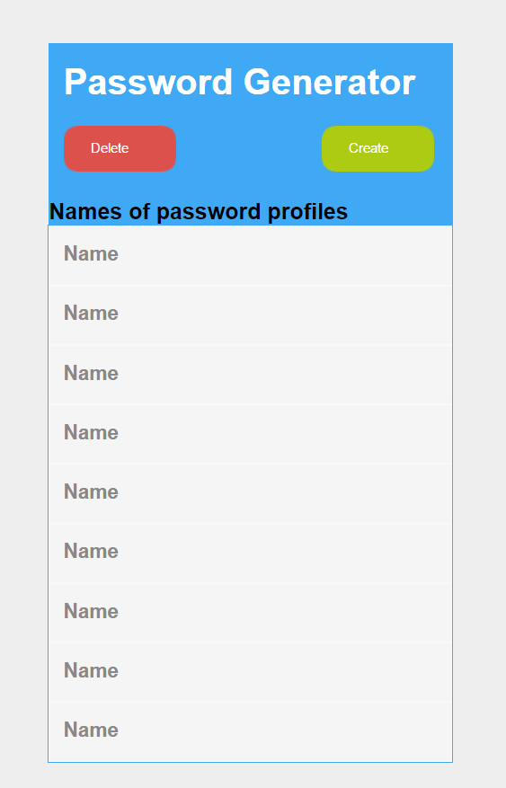
UI Mockup
Here is A Mockup design of our user interface

Slide 4
Features
Generates/stores passwords for each account
View all passwords associated with the user’s account
Delete outdated passwords

Slide 5
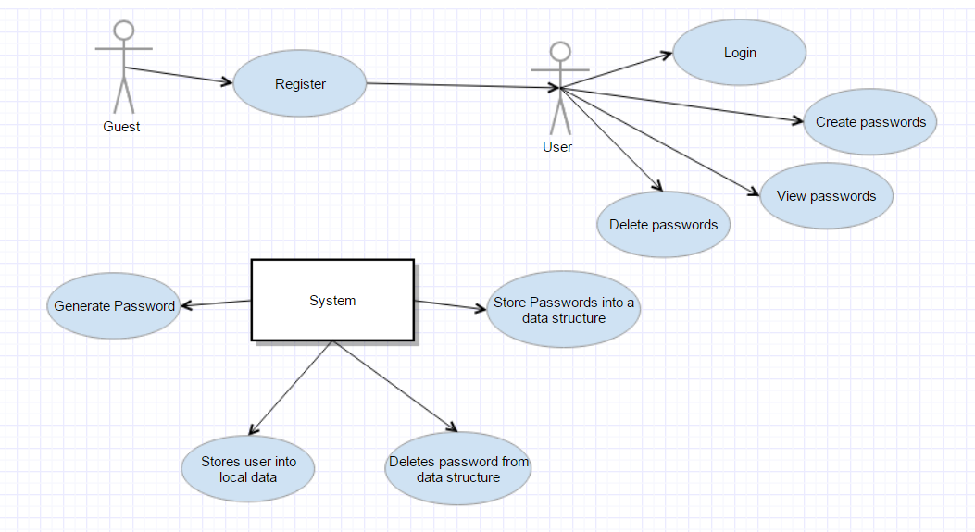
Design
User will register an account and login
Home page will allow user to manage all passwords
System will store and manage all passwords internally

Slide 6
Feasibility
Lack of experience with Android development
Ample experience with Java
Features
-Login page
-Registration
-Add/remove passwords
-Search through passwords
Simple Android UI

